Slide 1
NATURAL LANGUAGE PROCESSING
HOMEWORK – 3
By Ravinthiran Partheepan

Slide 2
Query
NLP areas where language models are applied?

Slide 3
Language Models in NLP
Language Modeling (LM) is one of the most important parts of modern Natural Language Processing (NLP).
Language model is required to represent the text to a form understandable from the machine point of view.

Slide 4
Applications of Language Modelling in NLP Areas:-
Machine Translation
Spelling Correction
Speech Recognition
Summarization
Question Answering
Sentiment Analysis

Slide 5
Machine Translation
Machine Translation (MT) is the task of automatically converting one natural language into another, preserving the meaning of the input text, and producing fluent text in the output language. While machine translation is one of the oldest subfields of artificial intelligence research, the recent shift towards large-scale empirical techniques has led to very significant improvements in translation quality.

Slide 6
Speech Recognition
Speech recognition technology can be used to perform an action based on the instructions defined by the human. The human needs to train the speech recognition system by storing speech patterns and vocabulary of their language into the system. By doing so, they can essentially train the system to understand them when they speak.
Algorithm used (ASR,CSR) – Automated Speech Recognition and Computer Speech Recognition.

Slide 7
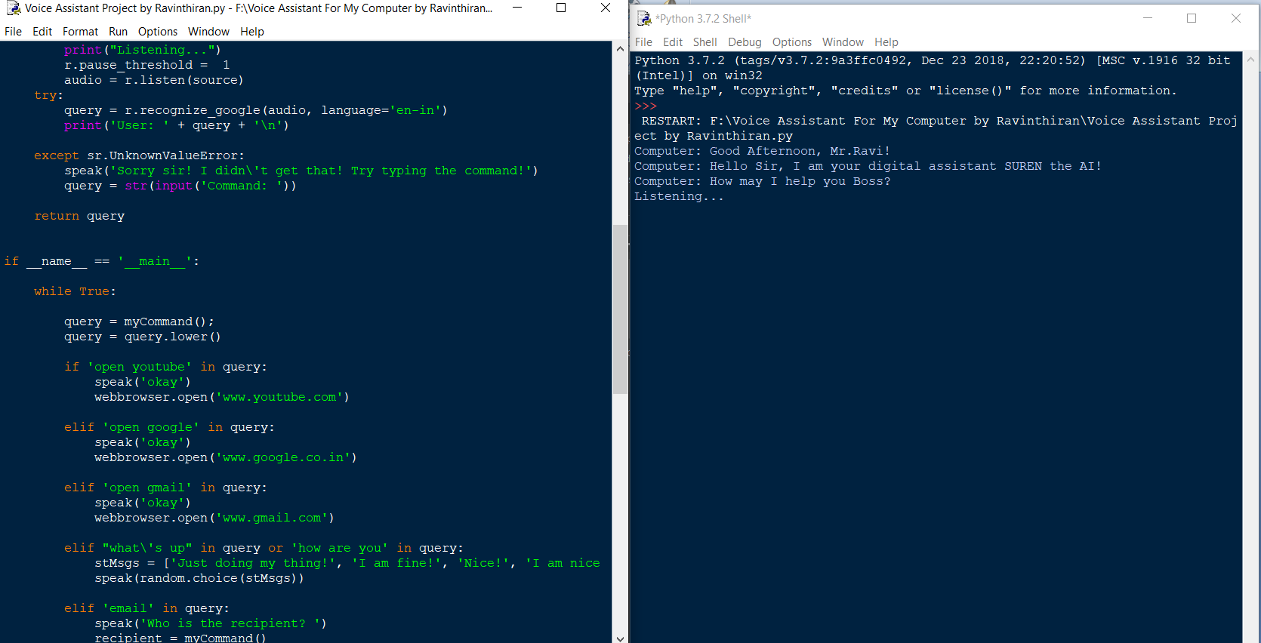
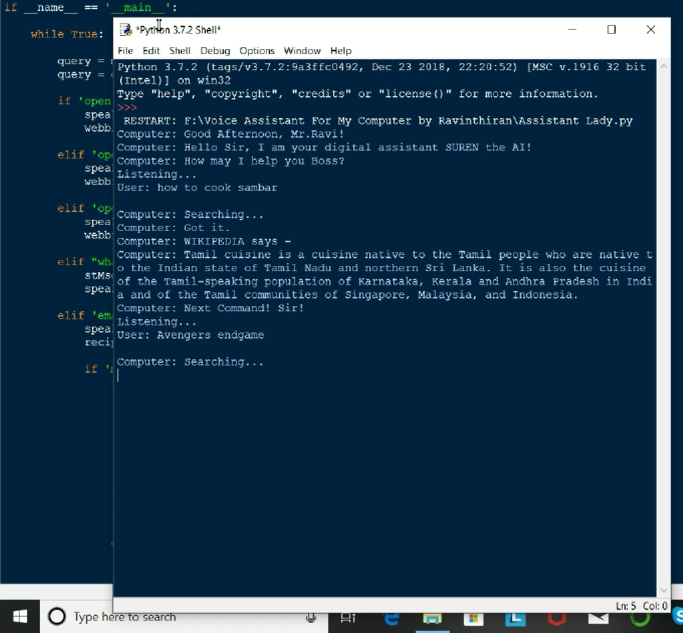
Speech Recognition O/P

Slide 8
Sentiment Analysis
Sentiment analysis is one of the most common applications in natural language processing. With Sentiment analysis, we can decide what emotion a text is written.
With the widespread use of social media, the need to analyze the content that people share over social media is increasing day by day. Considering the volume of data coming through social media, it is quite difficult to do this with human power. Therefore, the need for applications that can quickly detect and respond to the positive or negative comments that people write is increasing day by day.

Slide 9
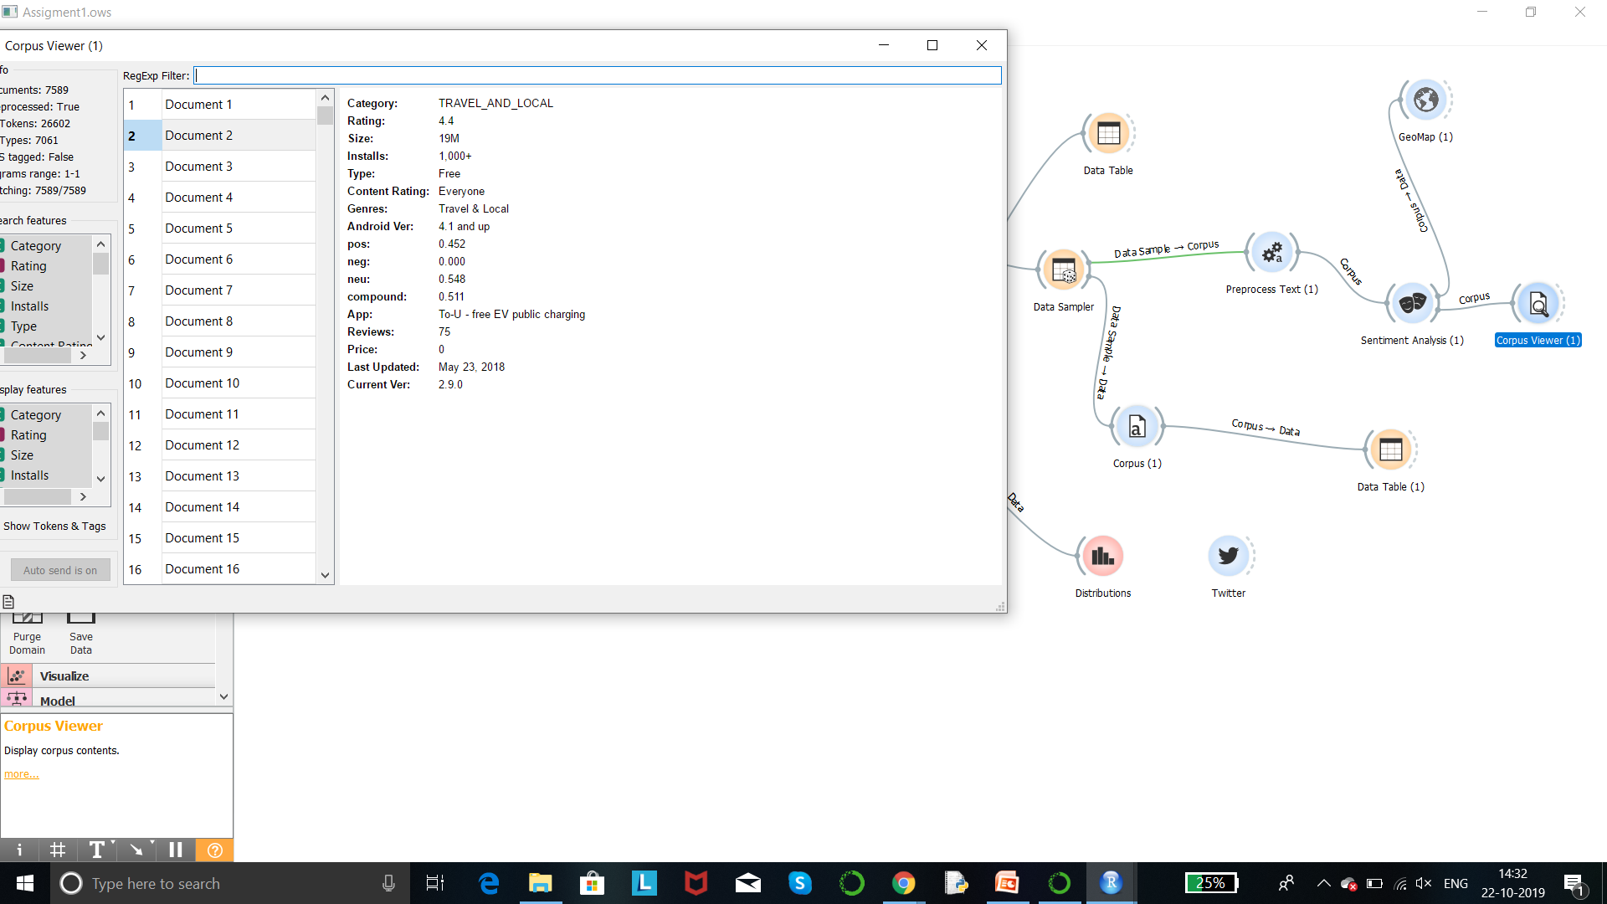
Sentiment Analysis on Amazon Products

Slide 10
Thank You!

